Slide 1
Introduction to Big Data and Hadoop

Slide 2
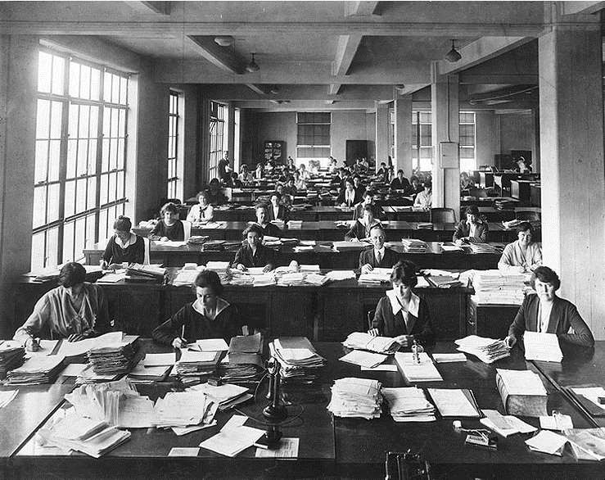
DATA GENERATION IN LAST FEW DECADES

Slide 4

DATA GENERATING NOW

Slide 5
What is Big Data?
‘Big Data’ is similar to ‘small data’, but bigger in size
Big Data is a term used to describe a collection of data that is huge in size and yet growing exponentially with time.
In short such data is so large and complex that none of the traditional data management tools are able to store it or process it efficiently.

Slide 6
Big data – Definition
“Big data is high-volume, high-velocity
and/or high-variety information assets that
demand cost-effective, innovative forms of
information processing that enable
enhanced insight, decision making, and
process automation”
- Gartner

Slide 7

Examples Of Big Data
The New York Stock Exchange generates about one terabyte of new trade data per day.

Slide 8

Social Media
500+terabytes of new data get ingested into the databases of social media site Facebook, every day.
This data is mainly generated in terms of photo and video uploads, message exchanges, putting comments etc.

Slide 9

A single Jet engine can generate 10+terabytes of data in 30 minutes of flight time.
With many thousand flights per day, generation of data reaches up to many Petabytes.

Slide 10
Characteristics Of Big Data
Volume :
– Google receives over 2 million search queries every minute
– transactional data or sensor data are being stored every fraction of
seconds
• Variety :
– YouTube, Facebook generate video, audio, image and text data
– Over 200 million emails are sent every minute
• Velocity:
– Particles collide 600 million times per second.
– Their Data Center processes about one petabyte of data every day.

Slide 11
VOLUME
Data At Rest
It refers to the vast amounts of data generated every second.
Problems related to storage of huge data reliably.
e.g. Storage of Logs of a
website, Storage of data by
gmail.
FB: 300 PB. 600TB/ day

Slide 12
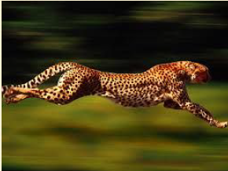
VELOCITY
Data In Motion
Refers to the speed at which new data is generated and the speed at which data moves around.
Problems Involving the handling of data coming at fast rate.
e.g. Number of requests
being received by Facebook,
Youtube streaming

Slide 13
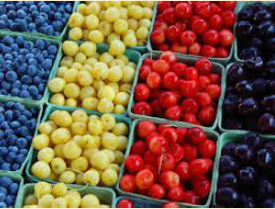
VARIETY
Data in Many Forms
Refers to the different types of data generated from different sources.
Problems involving
complex data structures
e.g. Maps, Social Graphs,

Slide 14
BIG DATA HAS ALSO BEEN DEFINED BY THE FIVE V’s
1.Volume
2.Velocity
3.Variety
4.Veracity
5.Value

Slide 15
BIG DATA Veracity
Veracity refers to the biases, noise and abnormality in data.
Removing things like bias, abnormalities or inconsistencies, duplication, and volatility are just a few aspects that affect the accuracy of big data.

Slide 16
BIG DATA Value
Data has intrinsic value—but it must be discovered.
•There are a range of quantitative and investigative
techniques to derive value from Big Data.
•The technological breakthrough makes much more accurate and precise decisions possible.
•Exploring the value in big data requires experimentation and exploration. Whether creating new products or looking for ways to gain competitive advantage.

Slide 17
Turning Big Data into Value
Value
Data Sources
Volume
Analysing Big Data:
ERP
CRM
Inventory
Finance
Conversations
Voice
Social Media
Browser logs
Photos
Videos
Log
Sensors
Etc.
Predictive
analysis
Text analytics
Sentiment analysis
Image Processing
Voice
analytics
Movement Analytics
Etc.
Velocity
Variety
Veracity

Slide 18
Big data – Challenges
• Capturing data
• Curation (Organizing, maintaining)
• Storage
• Searching
• Sharing
• Transfer
• Analysis
• Presentation

Slide 19
Problem 1: storing exponentially growing huge datasets
Data generated in past 2 years is more than the previous history in total
By 2020 , total digital data will grow to 44 Zettabytes approximately
By 2020, about 1.7 MB of new info will be created every second for every person.

Slide 20
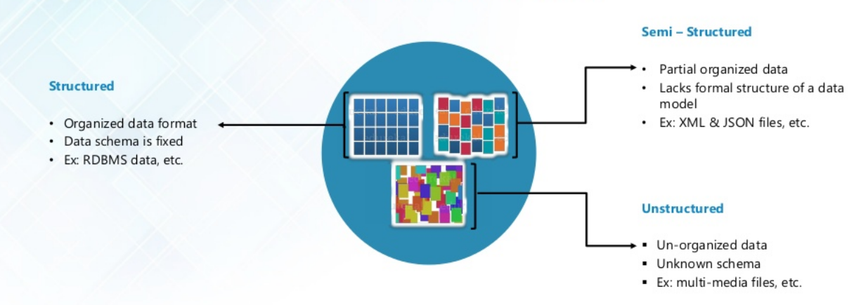
Problem 2: Processing data having complex structure

Slide 21
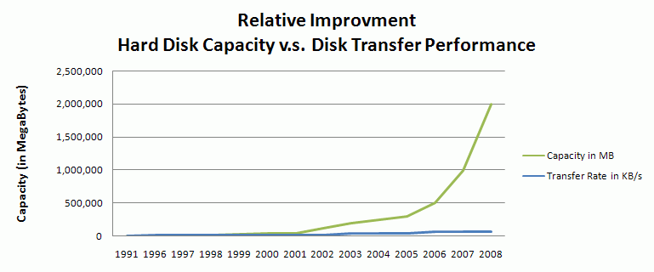
Problem 3: Processing data faster
The data is growing at much faster rate than that of disk read/write speed.

Slide 22
Types Of Big Data
Structured
Any data that can be stored, accessed and processed in the form of fixed format is termed as a 'structured' data.
Examples Of Structured Data
An 'Employee' table in a database is an example of Structured Data

Slide 23
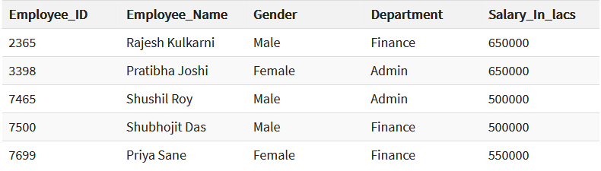

Slide 24
Unstructured
Any data with unknown form or the structure is classified as unstructured data.
In addition to the size being huge, un-structured data poses multiple challenges in terms of its processing for deriving value out of it.
Example: PDF,DOC,Audio, video, image file

Slide 25
Semi-structured
Semi-structured data can contain both the forms of data.
Example of semi-structured data is a data represented in an XML file.
Example 2: email data
Personal data stored in an XML file-

Slide 26
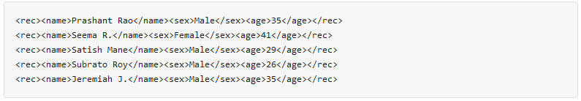

Slide 27
Benefits of Big Data Processing
Businesses can utilize outside intelligence while taking decisions.
Improved customer service
Early identification of risk to the product/services, if any
Better operational efficiency

Slide 28
Traditional vs. Big Data business approach
To store, analyze and process large amount of data is become tedious job for organization.
This can be fulfilled by implementing big data and its tools which are capable to store, analyze and process large amount of data at a very fast pace as compared to traditional data processing systems.
The major difference between traditional data and big data are discussed below.

Slide 29
Data architecture
Traditional data use centralized database architecture in which large and complex problems are solved by a single computer system.
Centralized architecture is costly and ineffective to process large amount of data.
Big data is based on the distributed database architecture where a large block of data is solved by dividing it into several smaller sizes.

Slide 30
Then the solution to a problem is computed by several different computers present in a given computer network.
The computers communicate to each other in order to find the solution to a problem.
The distributed database provides better computing, lower price and also improve the performance as compared to the centralized database system.

Slide 31
distributed database has more computational power as compared to the centralized database system which is used to manage traditional data.

Slide 32
Types of data
Traditional database systems are based on the structured data i.e. traditional data is stored in fixed format or fields in a file.
Traditional database only provides an insight to a problem at the small level.
However in order to enhance the ability of an organization, to gain more insight into the data.

Slide 33
Big data uses the semi-structured and unstructured data and improves the variety of the data gathered from different sources like customers, audience or subscribers.
After the collection, Big data transforms it into knowledge based information

Slide 34
Volume of data
The traditional system database can store only small amount of data ranging from gigabytes to terabytes.
However, big data helps to store and process large amount of data which consists of hundreds of terabytes of data or petabytes of data and beyond.
The storage of massive amount of data would reduce the overall cost for storing data and help in providing business intelligence.

Slide 35
Data schema
Big data uses the dynamic schema for data storage.
The traditional database is based on the fixed schema which is static in nature.

Slide 36
Data relationship
In the traditional database system relationship between the data items can be explored easily as the number of information stored is small.
However, big data contains massive or voluminous data which increase the level of difficulty in figuring out the relationship between the data items.

Slide 37
Scaling
Scaling refers to demand of the resources and servers required to carry out the computation.
Big data is based on the scale out architecture under which the distributed approaches for computing are employed with more than one server. So, the load of the computation is shared with single application based system.

Slide 38
However, achieving the scalability in the traditional database is very difficult because the traditional database runs on the single server and requires expensive servers to scale up.

Slide 39
Higher cost of traditional data
Traditional database system requires complex and expensive hardware and software in order to manage large amount of data.
Also moving the data from one system to another requires more number of hardware and software resources which increases the cost significantly.

Slide 40
While in case of big data as the massive amount of data is segregated between various systems, the amount of data decreases. So use of big data is quite simple, makes use of commodity hardware and open source software to process the data.

Slide 41
Accuracy and confidentiality
Under the traditional database system it is very expensive to store massive amount of data, so all the data cannot be stored.
This would decrease the amount of data to be analyzed which will decrease the result’s accuracy and confidence.

Slide 42
While in big data as the amount required to store voluminous data is lower.
Therefore the data is stored in big data systems and the points of correlation are identified which would provide high accurate results.

Slide 43
Distributed File Systems
Compute node: single processor, with its main memory, cache, and local disk
In the past, applications that called for parallel processing, such as large scientific calculations, were done on special-purpose parallel computers with many processors and specialized hardware.
large-scale Web services has caused more and more computing, result into installations of thousands of compute nodes operating more or less independently.

Slide 44
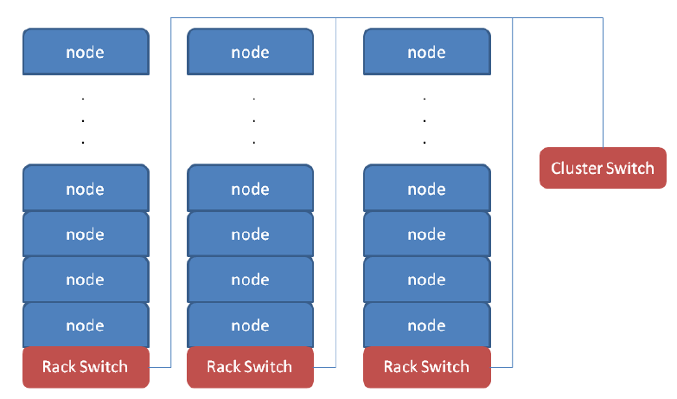
Physical Organization of Compute Nodes

Slide 45
Compute nodes are stored on racks.
The nodes on a single rack are connected by a network.
There can be many racks of compute nodes, and racks are connected by another level of network or a switch.
If any computer node fails then there is loss of a single node (e.g.,the disk at that node crashes) and the loss of an entire rack (e.g., the network connecting its nodes to each other and to the outside world fails).

Slide 46
Some important calculations take minutes or even hours on thousands of compute nodes.
If we had to abort and restart the computation every time one component failed, then the computation might never complete successfully.
The solution to this problem takes two forms:

Slide 47
Files must be stored redundantly. If we did not duplicate the file at several compute nodes, then if one node failed, all its files would be unavailable until the node is replaced. If we did not back up the files at all, and the disk crashes, the files would be lost forever.
Computations must be divided into tasks, such that if any one task fails to execute to completion, it can be restarted without affecting other tasks(MapReduce).

Slide 48
Large-Scale File-System Organization
Files are divided into chunks, which are typically 64 megabytes in size.
Chunks are replicated, perhaps three times, at three different compute nodes.
Moreover, the nodes holding copies of one chunk should be located on different racks, so we don’t lose all copies due to a rack failure.
Normally, both the chunk size and the degree of replication can be decided by the user.

Slide 49
To find the chunks of a file, there is another small file called the master node or name node for that file.
The master node is itself replicated, and a directory for the file system as a whole knows where to find its copies.
The directory itself can be replicated, and all participants using the DFS know where the directory copies are.

